Slide 1
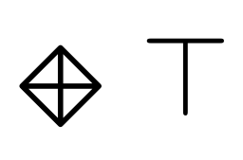
Agreement and disagreement relations
+
I have a friend (+): there exists a R+ successor.

Slide 2
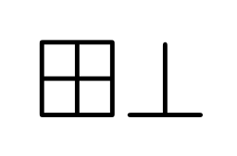
Agreement and disagreement relations
-
-
I don’t have friends (duality)

Slide 3
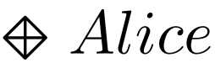
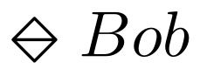
Agreement and disagreement relations
Bob
-
+
Alice
I’m friend of Alice
and enemy of Bob.

Slide 4
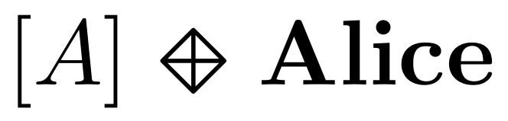

Agreement and disagreement relations
Everybody is friend of Alice (global modality)
+
+
+
+
Alice

Slide 5
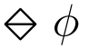
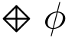
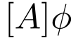
PNL Logic
holds for agent a whenever 𝜙 holds for some a’s enemy.
holds for agent a whenever 𝜙 holds for some a’s friend.
holds whenever 𝜙 holds for all agents

Slide 6
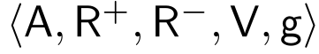
PNL Logic
holds for agent a whenever 𝜙 holds for some a’s enemy.
holds for agent a whenever 𝜙 holds for some a’s friend.
holds whenever 𝜙 holds for all agents
a R⁺ b: agent a agrees with (is a friend of) agent b
a R⁻ b: agent a disagrees with (is an enemy of) agent b
R⁺ is reflexive
R⁺ and R⁻ are symmetric.
These relations do not overlap

Slide 7
PNL Logic
holds for agent a whenever 𝜙 holds for some a’s enemy.
holds for agent a whenever 𝜙 holds for some a’s friend.
holds whenever 𝜙 holds for all agents
a R⁺ b: agent a agrees with (is a friend of) agent b
a R⁻ b: agent a disagrees with (is an enemy of) agent b
R⁺ is reflexive
R⁺ and R⁻ are symmetric.
These relations do not overlap
Optional axiom: collectively connectedness

Slide 8
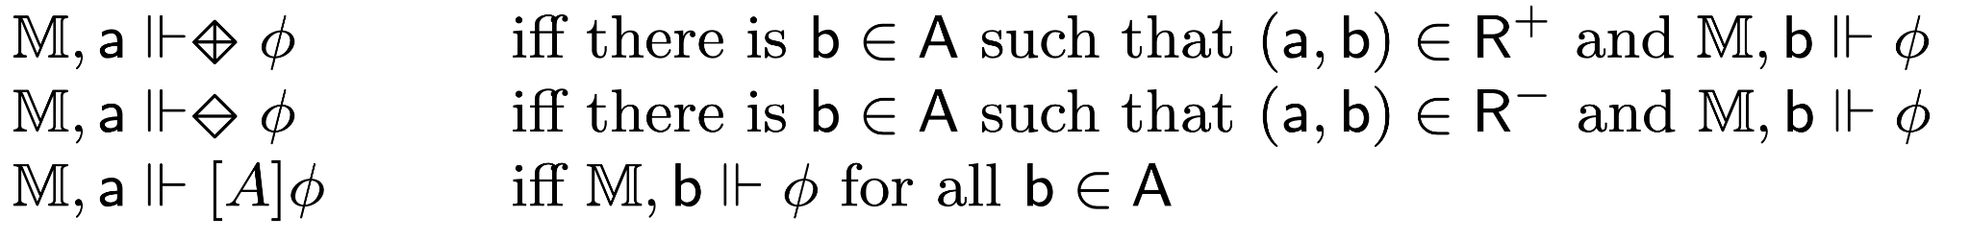
PNL Logic
holds for agent a whenever 𝜙 holds for some a’s enemy.
holds for agent a whenever 𝜙 holds for some a’s friend.
holds whenever 𝜙 holds for all agents
a R⁺ b: agent a agrees with (is a friend of) agent b
a R⁻ b: agent a disagrees with (is an enemy of) agent b

Slide 9
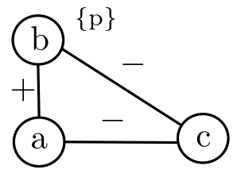


Semantic Game (truth in a model)
Proponent
F is true over 𝕄
Opponent
F is false over 𝕄
Model 𝕄
PNL
Semantic Game

Slide 10
Provability Game (validity)
Playing over all models
Proponent
F is true
Opponent
F is false
PNL
Semantic Game
Provability Game

Slide 11
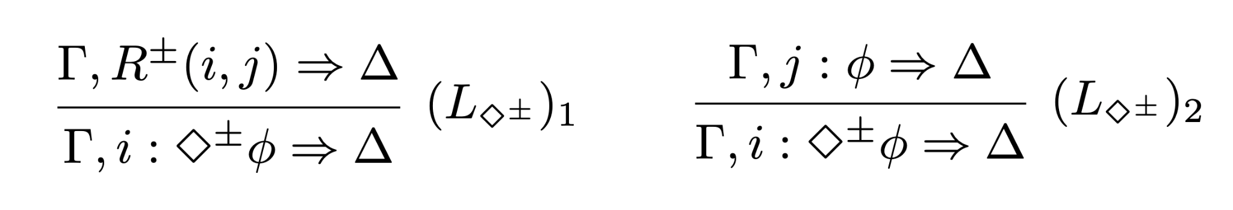
Analytic calculus
F is provable
F is not provable
PNL
Semantic Game
Provability Game
Sequent
Calculus

Slide 12
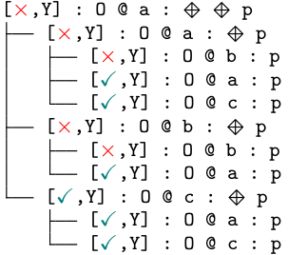

Our Contributions
Towards automation:
Intended meaning
Dynamics
Satisfiability
Semantic Game
Disjunctive states
Conditions for finiteness
Validity
Automatic procedures
Provability Game
Cut-free
Axioms as rules
Modular (different axioms)
Sequent Calculus

Slide 13
Semantic Game for PNL
Satisfiability : Played over a PNL model

Slide 14
Semantic Game for PNL
Satisfiability : Played over a PNL model
Players claim the truth of a formula

Slide 15
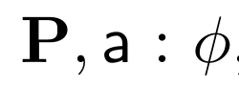
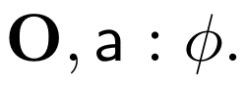
Semantic Game for PNL
Satisfiability : Played over a PNL model
Players claim the truth of a formula
Game states:
My and Your choices and strategies
P: Proponent
O: Opponent

Slide 16
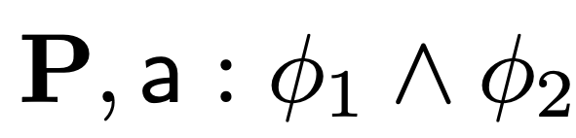
Semantic Game
Conjunction

Slide 17
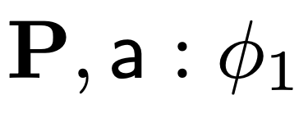
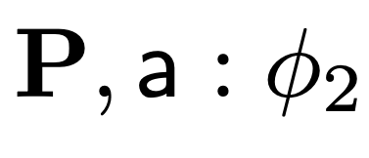
Semantic Game
Conjunction
YOU

Slide 18
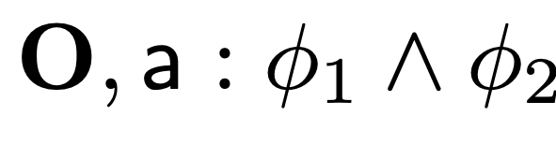
Semantic Game
Conjunction

Slide 19
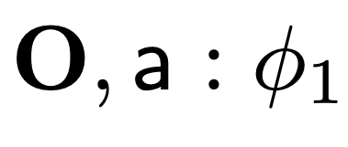
Semantic Game
Conjunction
ME

Slide 20
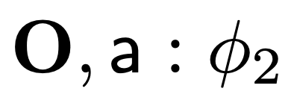
Semantic Game
Conjunction
ME

Slide 21
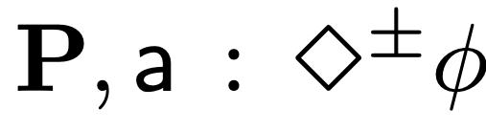
Semantic Game
Diamond

Slide 22
Semantic Game
Diamond
No a-successor, then you win

Slide 23
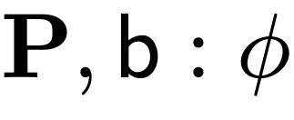
Semantic Game
Diamond
ME

Slide 24
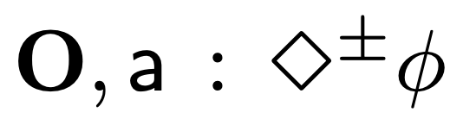
Semantic Game
Diamond

Slide 25
Semantic Game
Diamond
No a-successor, then I win!

Slide 26
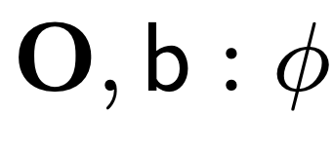
Semantic Game
Diamond
YOU

Slide 27
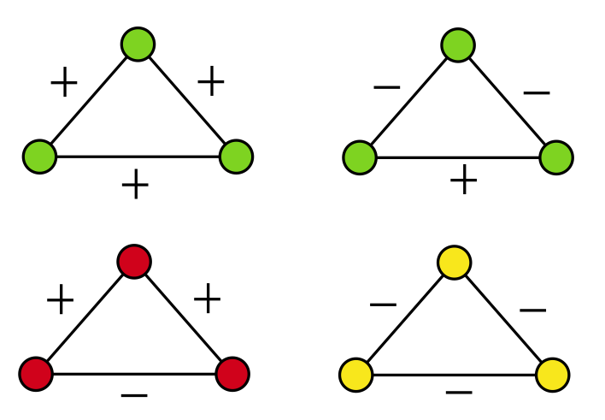
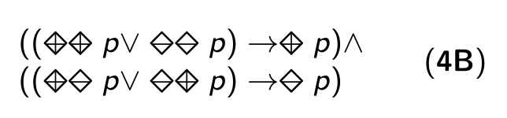
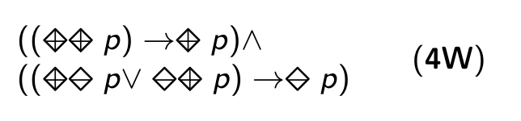
An example: Balance (stable configurations)

Slide 28
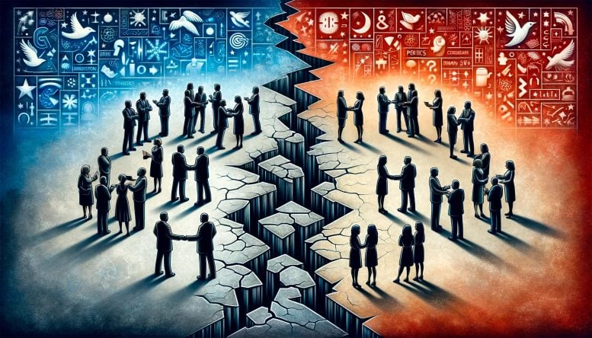
An example: Balance (stable configurations)
From scitechdaily.com

Slide 29
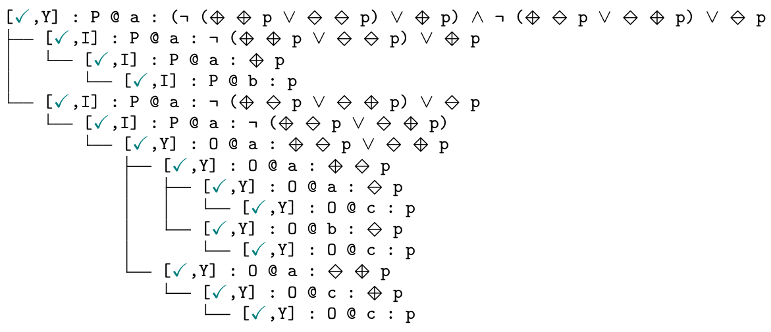
Dynamics: playing the game

Slide 30
Dynamics: playing the game

Slide 31
Dynamics: playing the game

Slide 32
Dynamics: playing the game

Slide 33
Dynamics: playing the game

Slide 34
Dynamics: playing the game

Slide 35
Dynamics: playing the game
I win!

Slide 36
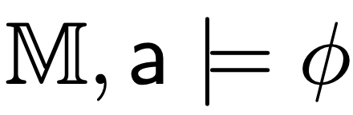
Semantic Game G_{𝕄}
Theorem 1.
I have a winning strategy in 𝕄 for
iff

Slide 37
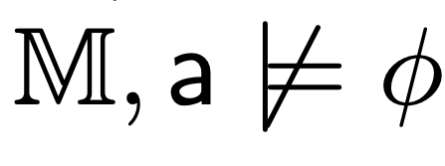
Semantic Game G_{𝕄}
Theorem 1.
I have a winning strategy in 𝕄 for
iff
2. You have a winning strategy in 𝕄 for
iff

Slide 38
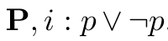
What about validity?
There is no a uniform strategy for winning the game

Slide 39
What about validity?
There is no a uniform strategy for winning the game
Validity/disjunctive game:
Multiset of game states.

Slide 40
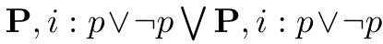
What about validity?
There is no a uniform strategy for winning the game
Validity/disjunctive game:
Multiset of game states.
The ability to duplicate states.

Slide 41
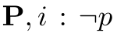
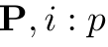
What about validity?
There is no a uniform strategy for winning the game
Validity/disjunctive game:
Multiset of game states.
The ability to duplicate states.
,
{
}

Slide 42
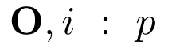
What about validity?
There is no a uniform strategy for winning the game
Validity/disjunctive game:
Multiset of game states.
The ability to duplicate states.
The model is relevant “only” in elementary states.
,
{
}
,
{
}

Slide 43
Disjunctive games
Disjunctive game DG(P, i : 𝜙) can be thought of as
Me and You

Slide 44
Disjunctive games
Disjunctive game DG(P, i : 𝜙) can be thought of as
Me and You
playing all semantic games G(P, i : 𝜙)

Slide 45
Disjunctive games
Disjunctive game DG(P, i : 𝜙) can be thought of as
Me and You
playing all semantic games G(P, i : 𝜙)
over all PNL-models 𝕄

Slide 46
Disjunctive games
Disjunctive game DG(P, i : 𝜙) can be thought of as
Me and You
playing all semantic games G(P, i : 𝜙)
over all PNL-models 𝕄
Winning condition: I win (and you lose) if for every PNL model there is an elementary game state where I win the semantics game.

Slide 47
Adequacy
Theorem 2
I have a winning strategy for the disjunctive game DG(F) iff F is valid.

Slide 48
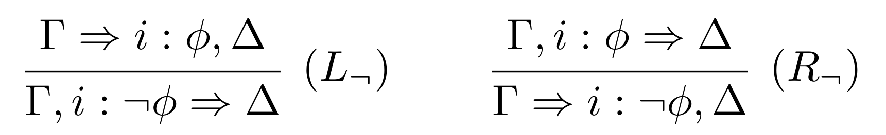
A proof system
Left/Right Opponent/Proponent

Slide 49
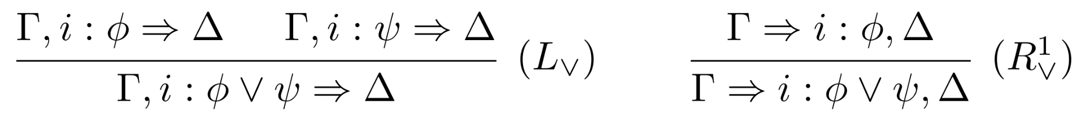
A proof system
Your choices: branches
My choices: decision

Slide 50
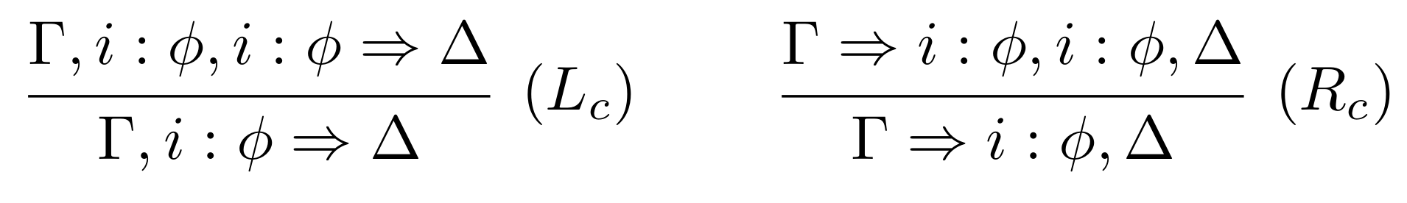
A proof system
Disjunctive games: contraction

Slide 51
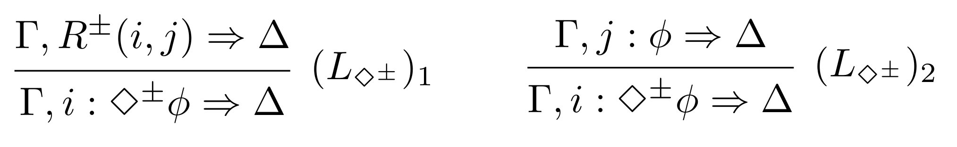
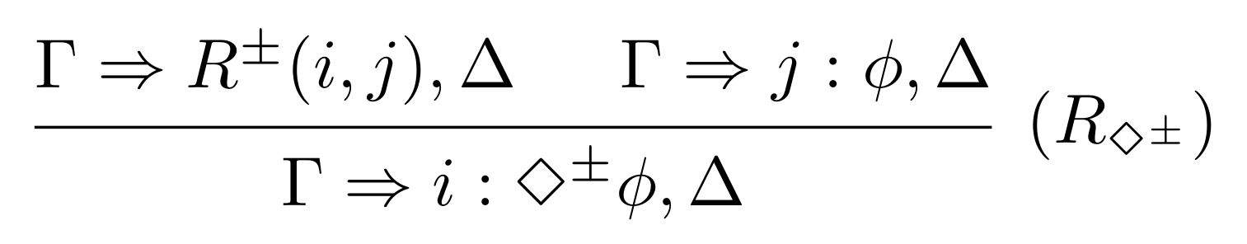
A proof system
Fresh nominals (your best strategy)

Slide 52
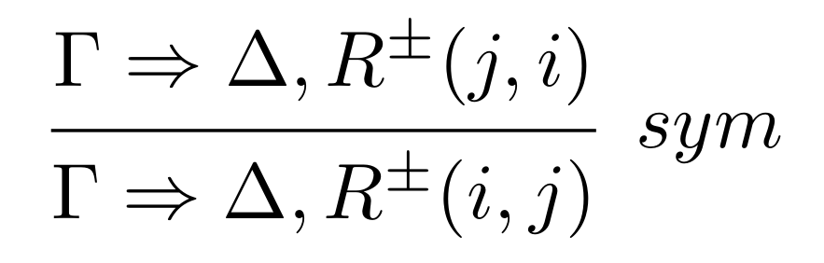
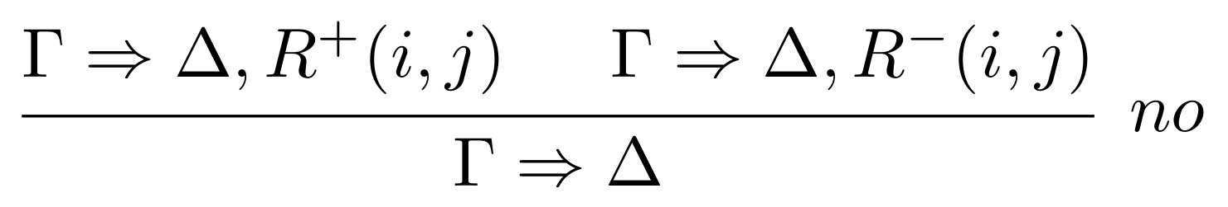
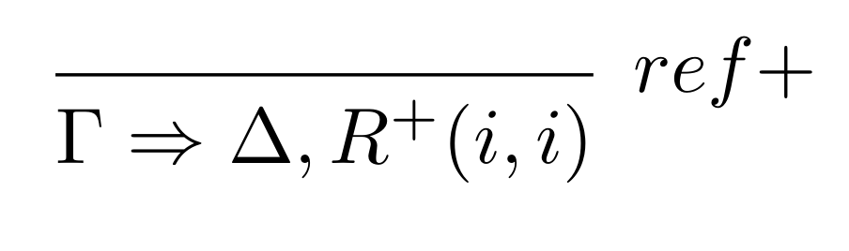
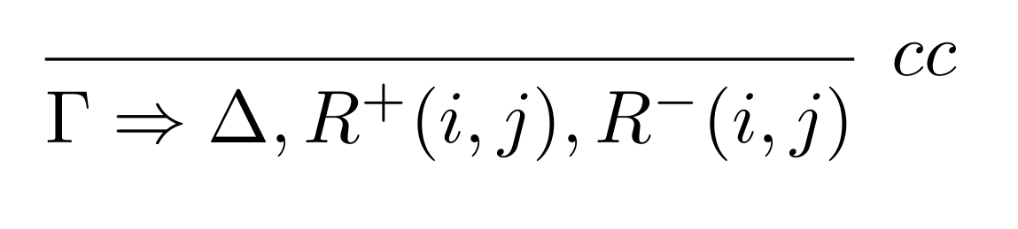
A proof system
Frame axioms: Relational Rules

Slide 53
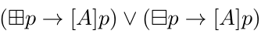
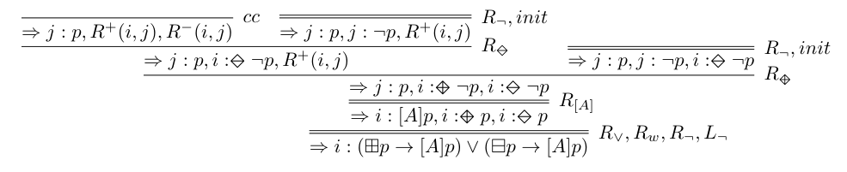
A proof system: Example
Collective connectedness

Slide 54
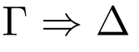
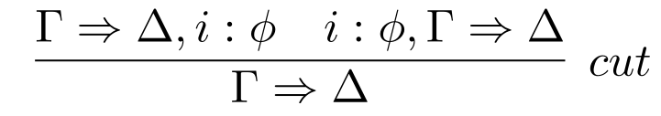
A proof system
Theorem 3
I have a winning strategy for the disjunctive game DG( ) iff
is provable in DS.
Theorem 4
The following rule is admissible

Slide 55
Dynamics
(Globally) adding new positive or negative links
(Locally) changing the polarity of one link
Extended PNL
Semantic Game
Provability Game
Sequent
Calculus

Slide 56




Example: reconciliation

Slide 57
Conclusion
Semantic game: concrete scenarios and meaning.
Disjunctive game: validity.
A method for obtaining cut-free sequent system from the game.
Frame properties as sequent rules.
Perspectives
Relaxing symmetry.
Games with budget (limiting the changes).
More on automation (strategies and focusing).

Slide 58


Thanks!

Slide 59





Thanks!
Leverhulme project 2024 (ECUMENICAL)
SGR project PROMUEVA (Minciencias)
NATO Science for Peace and Security Programme project SymSafe
European Union’s Horizon 2020 (Mosaic)

Slide 60

Questions?

